Slide 1
G.R.E.A.T.®
Consistent, Connected, System-wide Communication

Slide 2
Objectives for G.R.E.A.T.® Trainers
Appreciate why a communication framework is needed
Discuss the components of G.R.E.A.T. ®
Demonstrate G.R.E.A.T. ® encounters
Develop a G.R.E.A.T. ® roll out plan
Strategies to hardwire G.R.E.A.T. ® into daily workflows
Means of sustaining and monitoring G.R.E.A.T. ®

Slide 3
Strategic Map
Insert your organization’s mission/vision/values statement

Slide 4
Service Standards Connect Mission/Vision/Values to Culture
Mission
What we do.
Vision
Where we go.
Culture
Values
Who we are.

Slide 5
The Role and Importance of the Patient Experience
Improves medical outcomes
Increases patient loyalty
Increases patient safety
Creates a professional satisfying work environment

Slide 6
G.R.E.A.T. ® – Our Service Standard

Slide 7
Service Standard
Everything we say matters…everyone is listening.
Everything we do matters…everyone is watching.
Good Culture
Great Culture

Slide 8
G.R.E.A.T. ® – Our Service Standard
Greet
Relate
Explain
Introduce yourself in a welcoming, reassuring way.
Actively listen for needs and respond in an authentic, empathetic manner.
Thank
Ask
Clarify your role and the situation/plans as clearly as possible.
Inquire with open-ended questions to gauge understanding.
Show gratitude for the interaction and wish them well.

Slide 9
Goals of G.R.E.A.T. ®
Improve patient perception of care
Reduce fear and anxiety
Minimize complaints and misperceptions
Increase compliments
Improve patient adherence to optimal treatment
Strengthen relationships between patients and coworkers

Slide 10
G.R.E.A.T. ® – Our Service Standard
YouTube Link to Training Video

Slide 11
G. | Greet
Make others feel welcome, builds trust
Ask permission to enter the room
Smile and make eye contact at all times
Show a positive attitude
Acknowledge the patient by name
Greet everyone accompanying the patient
Introduce yourself by name/title, share your role on the team of care givers
Hand off to others by using their name/title and role

Slide 12
R. | Relate
Demonstrates concern, empathy and compassion. Builds relationship.
Use patient/customer name
Relate to the person in some way, ask about their career, family, pets, weather. Offer a compliment
If an appointment, state “Yes, we’re expecting you.”
Use empathy statements: “I’m so sorry you’re not feeling well.”
Understand patient’s sense of urgency – we will take care of that right away
Use calm tone of voice. Offer comfort by briefly/gently touching arm
Listening carefully is the most important way to relate

Slide 13
E. | Explain
Narrate what will happen – ease fear, manage expectations
USE UNDERSTANDABLE LANGUAGE (i.e., no acronyms or medical terms)
Explain what exactly is happening and forecast what is coming up
Detail unfamiliar procedures
Estimate duration and associated waiting (begin test , get results, etc.)
Review how what is going on fits in with the overall plan of care

Slide 14
A. | Ask
Manage and anticipate expectations. Clarify understanding
Anticipate the person’s concerns and provide answers
Avoid questions with a yes / no answer such as “Do you have any questions?” or “Do you understand?”
Use questions that require a sentence or more response, such as:
Tell me about your medications?
Can you explain your understanding of these results?
Where do you plan to park when you arrive the morning of surgery?
A question that work in every context is “What is your greatest concern?

Slide 15
T. | Thank
Show your appreciation for the interaction
Thank you for choosing our facility
Thank you for waiting
Thank you for trusting us to care for you
Thank you for letting me care for you today
I hope you are feeling better
May I assist you with anything else?

Slide 16
G.R.E.A.T. ®…Not JUST for Face-to-Face Interactions
Fundamentals of Communication
Effective tool for email and telephone too!

Slide 17
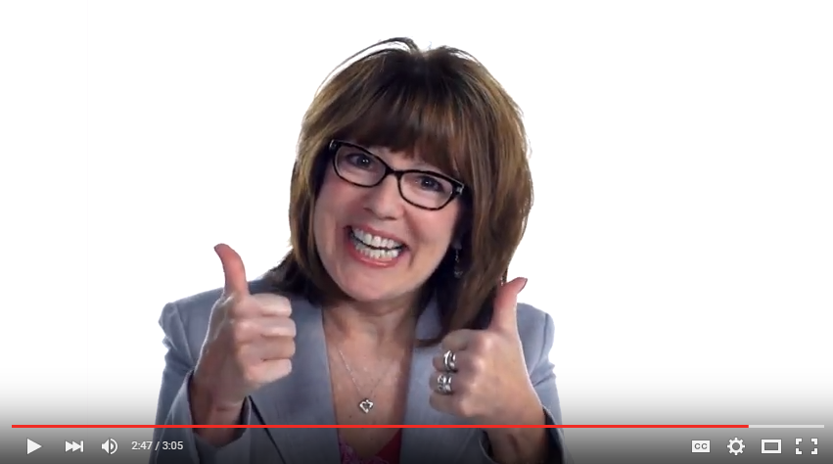
G.R.E.A.T. ® – Our Service Standard

Slide 18
Attitude is Everything!
Develop your own G.R.E.A.T. ® interactions to show everyone how G.R.E.A.T. ® you are!

Slide 19
Training Your Team | Ideas for Hardwiring
Everyone should practice G.R.E.A.T. ®
Ask staff for improvement ideas and incorporate them
Designate a patient experience champion an “influencer” within the group that will be responsible for the initiative
G.R.E.A.T. ® should be based on buy-in, not force
Include G.R.E.A.T. ® in daily huddles and rounds
Share patient comments that pertain to G.R.E.A.T. ®

Slide 20
Training Your Team | Critical Role of the Leader
The goal is to sustaining skill use
Employee behavior reflects ability and environment
New behaviors extinguish rapidly in an unsupportive environment
The actions of one’s Manager is a powerful influence
Leading by example
Coaching

Slide 21
G.R.E.A.T. ®
Consistent, Connected, System-wide Communication

